Slide 1

Cricket song classification using transformers
Tanu Shree
Computer Science M.S. Student, Texas A&M University, College station , TX
Committee:
Dr. Yoonsuck Choe (Chair)
Dr. Shuiwang Ji
Dr. Hojun Song
March 4, 2024

Slide 2
Content
Introduction
Motivation and Background
Problem Statement
Concepts Used
Methods
Dataset
Feature Extraction
Model Configuration
Experiments
Species(Gryllus Genus) Dataset
Genus Dataset
Results and Analysis
t-SNE plots
Experimental results
Discussion and Conclusion

Slide 3
Introduction

Slide 4
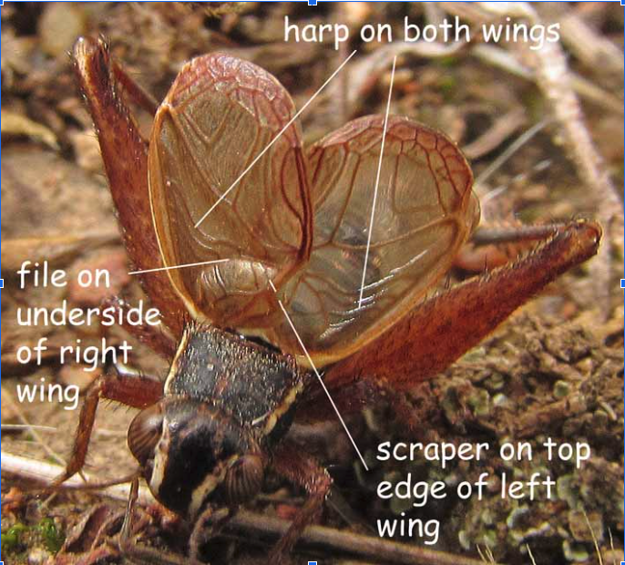
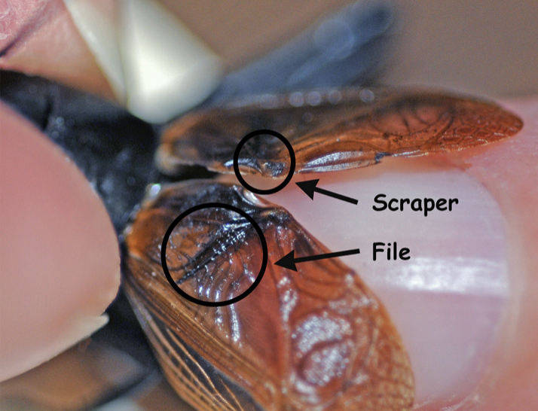
Motivation
Why and how do Crickets sing?
Male crickets sing mainly to attract a female. They also make aggressive sound when another male cricket invade their territory.
To sing, male crickets rub their forewings together(process is called Stridulation ). One wing with scraper is rubbed against the file in another wing.
Each species has a unique sound. Songs from the same species can also differ based on location, temperature and intension[1][2].
Applications of studying cricket songs:
Studying cricket songs contribute to understanding the evolution in acoustic communication of crickets.
The study can be used in agriculture (pest management) and preserving the natural biodiversity (conservational education).
AI based application can be used to identify these insects and contribute to ecological studies.

Slide 5
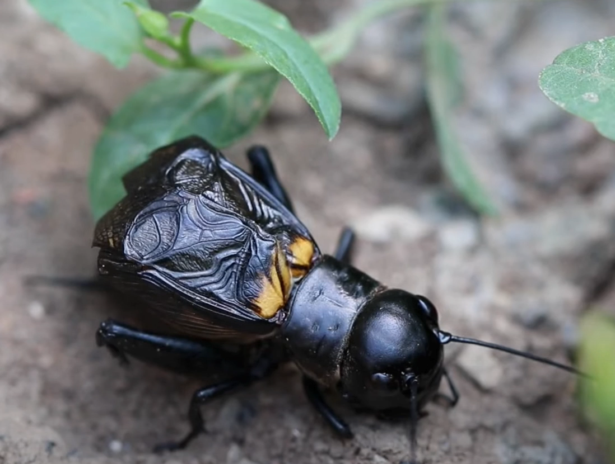
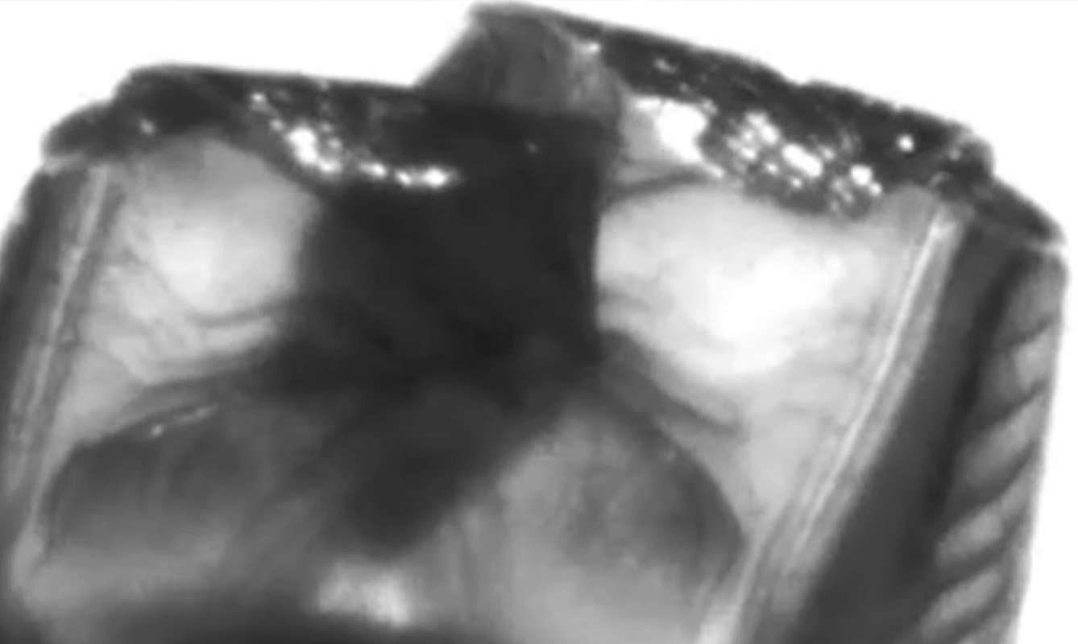
Zoomed and slow-motion view of stridulation. Top wing has file and bottom wing has scraper.
Field cricket of ‘Gryllus’ genus

Slide 6
background
Biologists traditionally analyzed song patterns using morphological characteristics, recordings and spectrograms, noting the variations influenced by factors like temperature and time of day.
Similar Bird Song Classification Projects using ML techniques.
extensive prior research on bird song classification due to competitions such as BirdCLEF.
Insufficient Cricket Song Machine Learning Research.
Cricket songs contain complex patterns and variations that can be challenging to analyze manually. ML models, especially those like transformers, are adept at recognizing and understanding intricate patterns in data.
Previous studies explored the use of Convolutional Neural Network (CNN) models like LeNet-5 and SCNNB for species and genus classification with accuracy of 92.28% and 94.30% respectively (using SCNNB)[3].

Slide 7
Problem Statement
The focus of this research is to assess how well the transformer models perform on small, noisy, and imbalanced datasets, addressing the following questions:
Can transformer models effectively classify crickets based on their songs?
How do transformer models perform on different types of datasets, including small, evenly distributed, and sparsely distributed datasets?
What is the comparative performance of transformer models against previously utilized models like SCNNB and LeNet-5?

Slide 8
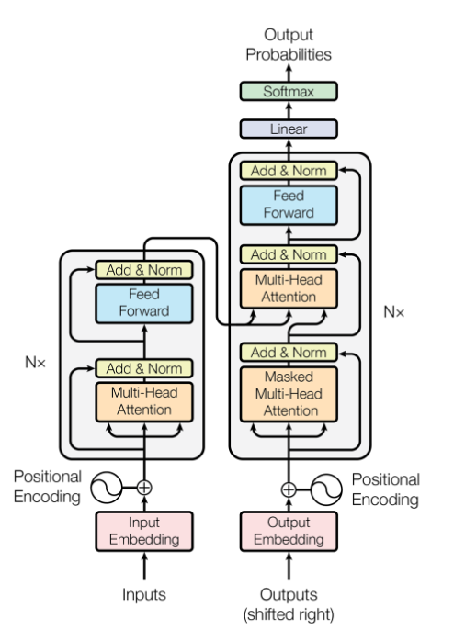
Concepts Used
Transformers:
Transformers utilize attention mechanism which enables capturing long-range dependencies in the input data efficiently.
Long-range dependencies refer to relationships or connections between distant elements in a sequence or data set.
Attention is a mechanism in neural networks that allows models to focus on specific parts of the input data (such as words in a sentence or pixels in an image) by assigning different weights to different parts of the input, emphasizing the most relevant information.
A set of attention scores are calculated between each pair of tokens in the sequence (calculated using dot product) and then used to compute a weighted sum of the corresponding token embeddings.
Multi-headed attention is an extension of self-attention, which allows the model to capture diverse patterns and dependencies in the input data in different contexts.
Transformer Architecture. Left is encoder and right is decoder[4].

Slide 9
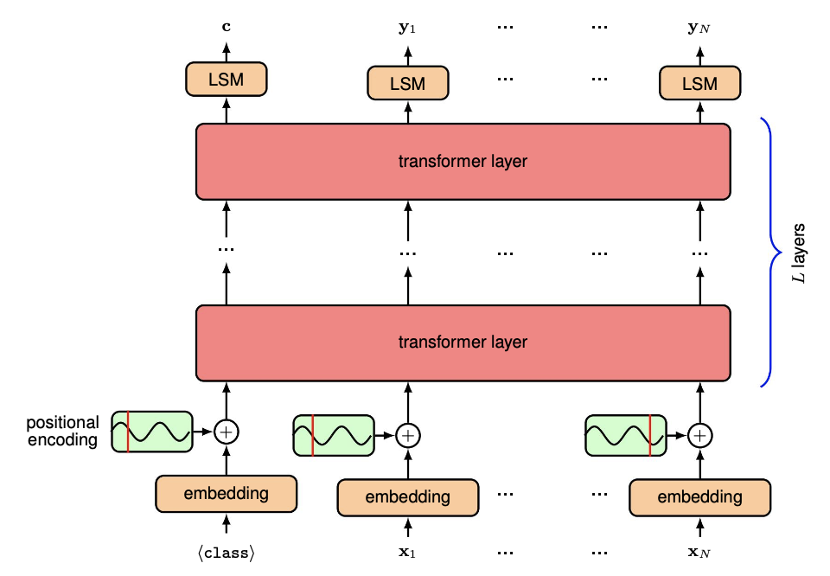
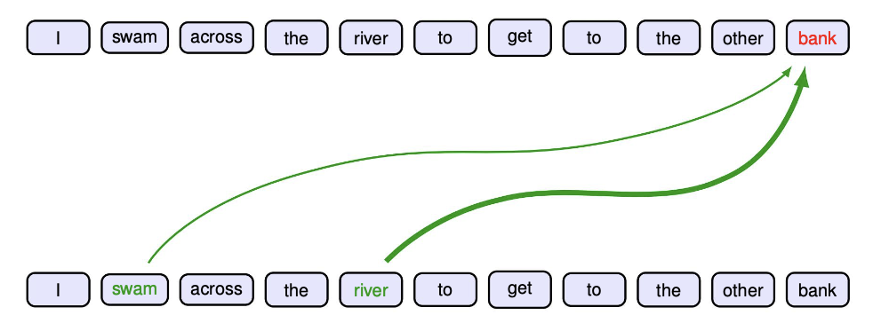
Attention mechanism: The word ‘bank’ is influenced by terms ‘swam’ and ‘river’. Thickness represent the relevance[5].
Architecture of encoder transformer[5].

Slide 10
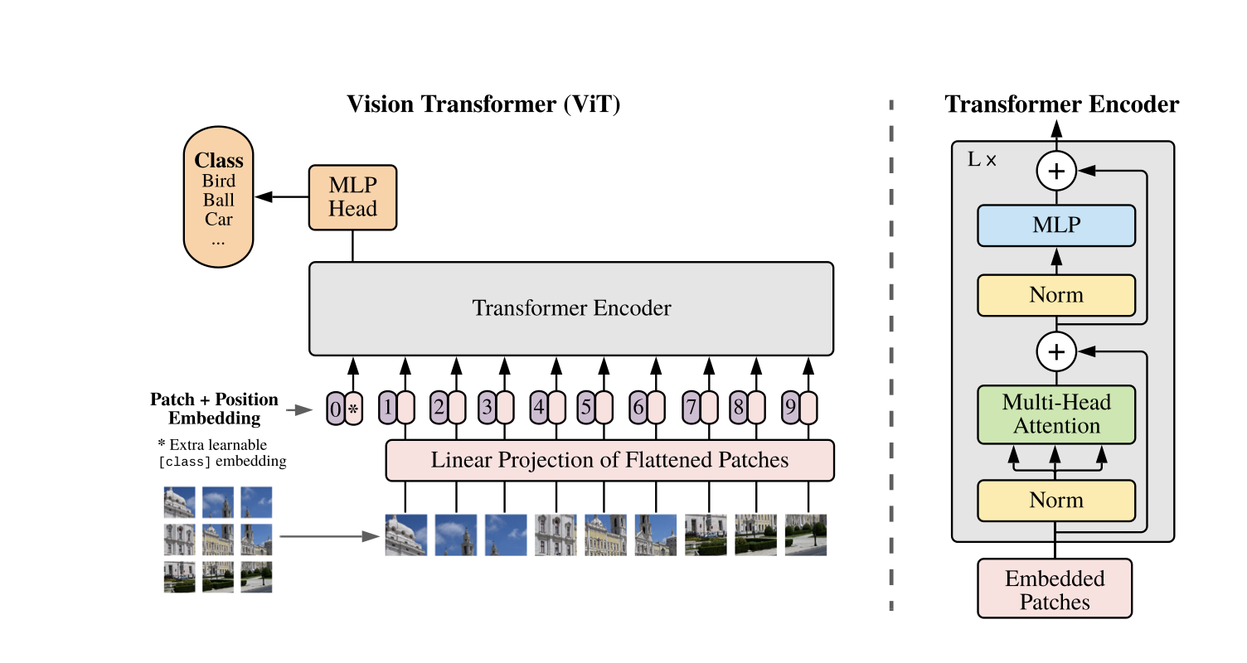
Concepts Used
Vision Transformers (ViT):
In this research, we use Vision Transformer which only applies the Encoder Transformer.
ViT treats images as sequences of patches and processes them using transformer layers to extract features and make predictions.
Images are divided into small pieces call patches, which are then flattened into sequence of vector for model to understand.
Special token CLS along with positional embedding is attached to the input sequence.
This sequence is then, passed through Transformer encoder.
The output is transformed by a linear layer with a SoftMax activation (LSM) and gives the final classification predictions.
Vision transformer architecture for classification of image[6].

Slide 11
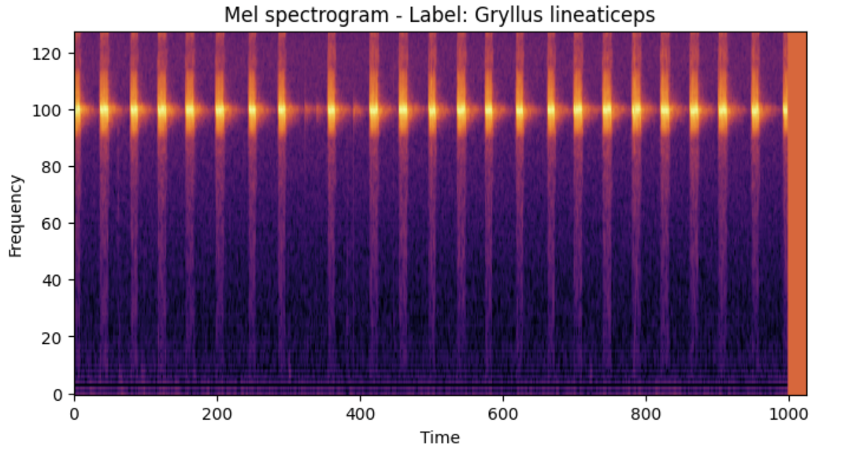
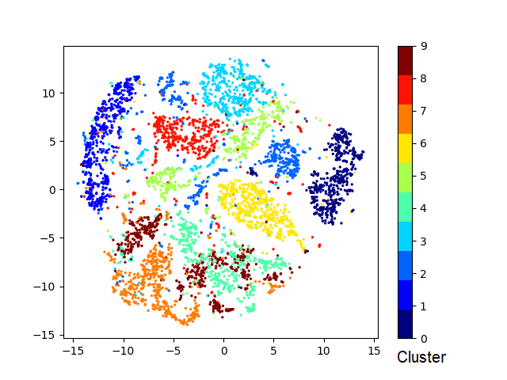
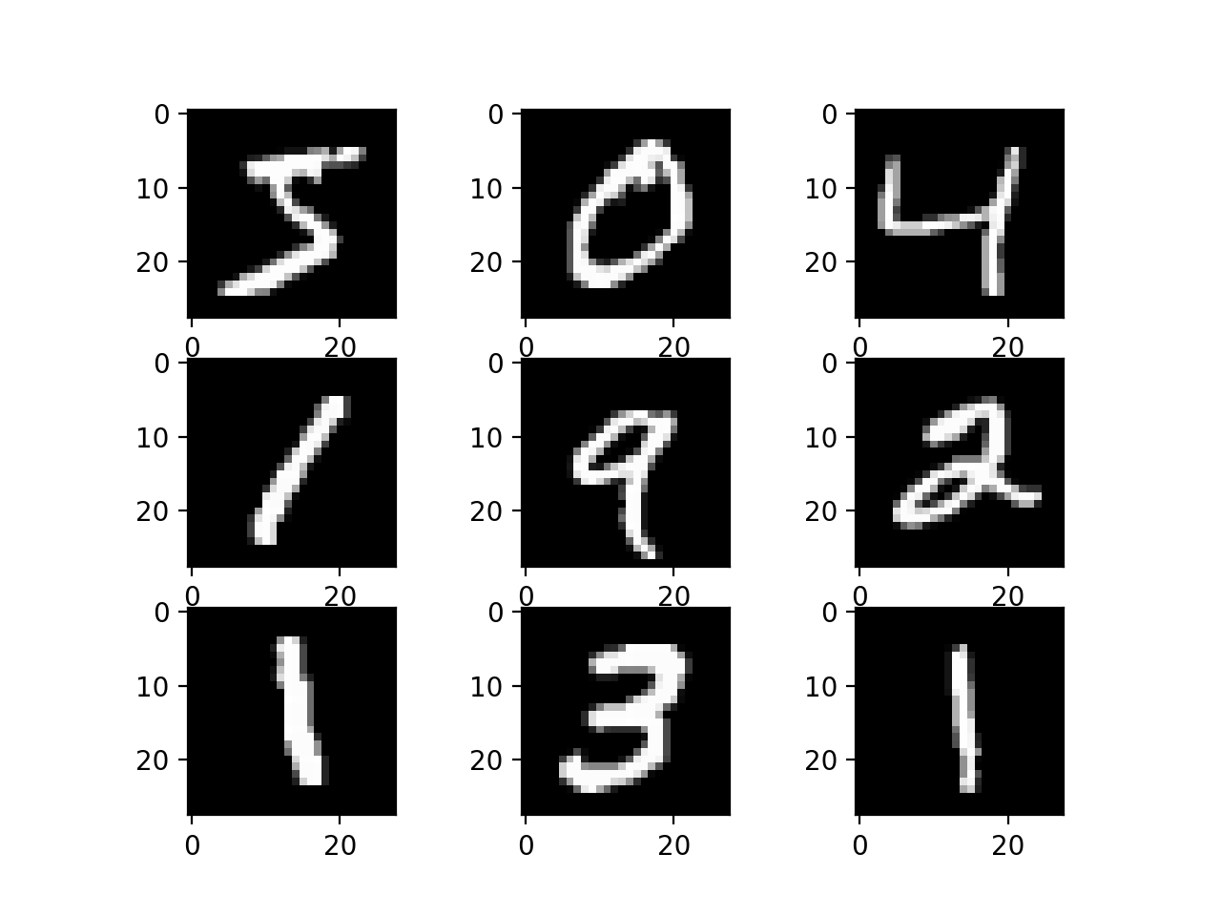
Concepts Used
Mel Spectrograms:
Mel spectrogram images are like visual snapshots of sound. The x-axis represents the time frames and y-axis represents the frequency bins. Images capture the key frequency patterns for time specific frames.
PCA (Principal Component Analysis ):
PCA is a statistical method used to simplify and understand complex datasets. It works by finding the most important patterns or "principal components" in the data and representing the high dimensional data in a lower-dimensional space.
t-SNE (t-Distributed Stochastic Neighbor Embedding):
t-SNE is a machine learning technique used for visualizing high-dimensional data in a lower-dimensional space, typically 2D or 3D.
It preserves the local and global arrangements of data by positioning similar data points together and dissimilar ones far apart from each other on the prescribed lower dimensional space.
Mel Spectrogram image of 10 second sample of an audio files in dataset..
T-SNE plotting for MNIST dataset[7].
Subset of images from MNIST dataset[8].

Slide 12
methods

Slide 13
Dataset
Available data:
Species Dataset (Gryllus Genus):
592 audio files containing recorded cricket songs from different species under ‘Gryllus’ genus. Total 11distinct species.
Genus Dataset:
441 audio files both from SINA (Singing Insects of North America) and MCL (Cornell’s Macaulay library). Total 26 different genuses.

Slide 14
Challenges and solution:
Small dataset size and class imbalance:
Audio files resampled into 10 seconds samples with 5 seconds overlap.
Undersampling and oversampling done to further balance the data.
Uneven distribution within audio files
Dataset divided into subsets based on number of audio files for each class, for both , species dataset(Gryllus genus) and genus dataset.
Species sub datasets: 9 species (more than 10 audio files), 5-species (more than 50 audio files) and 3-species (more than 70 audio files).
Genus sub datasets: 11 genus (more than 10 audio files), 8 genus (more than 15 audio files), 5 genus ( more than 30 audio files) and 3 genus (more than 60 audio files).
Noisy data:
Human Voiceover addressed by applying VAD (Voice Activity Detection) technique.
Other background noise like telephone ring, bird call etc. removed by using high pass filter. Audio occurring at frequencies lower than a defined threshold ( 2KHz) “zeroed out”.

Slide 15
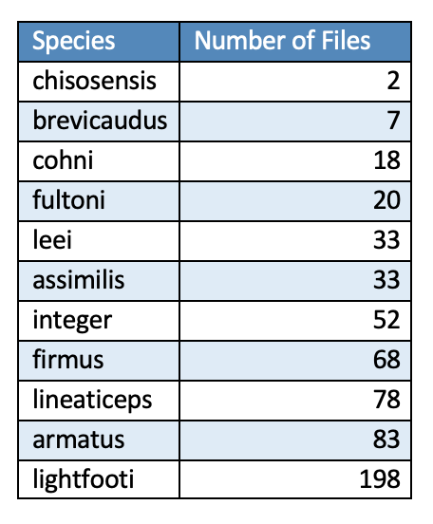
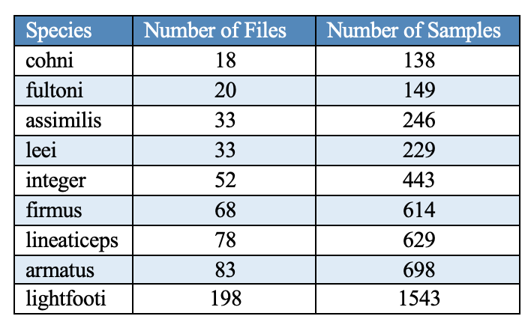
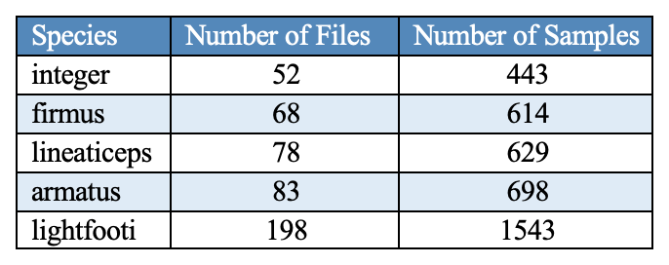
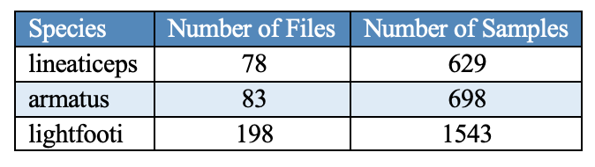
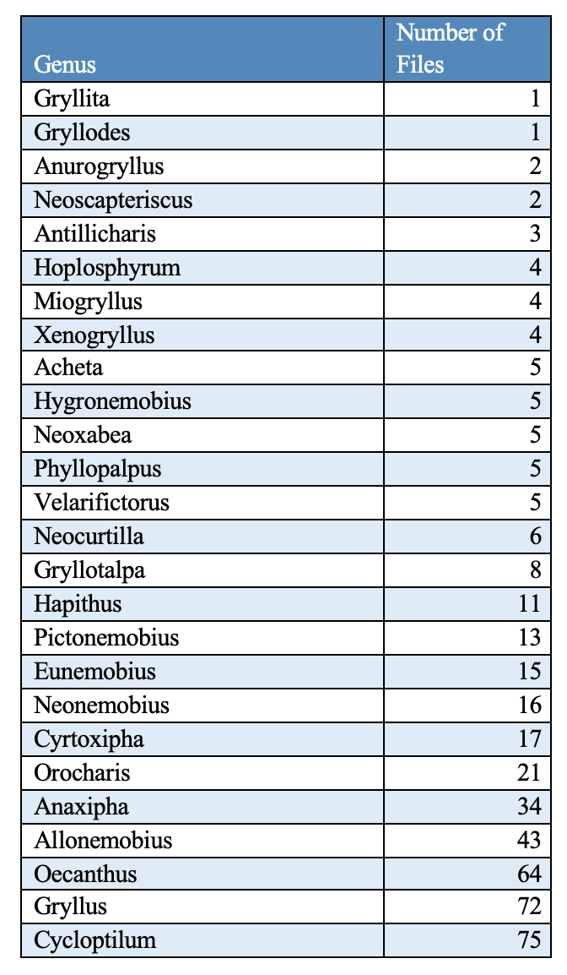
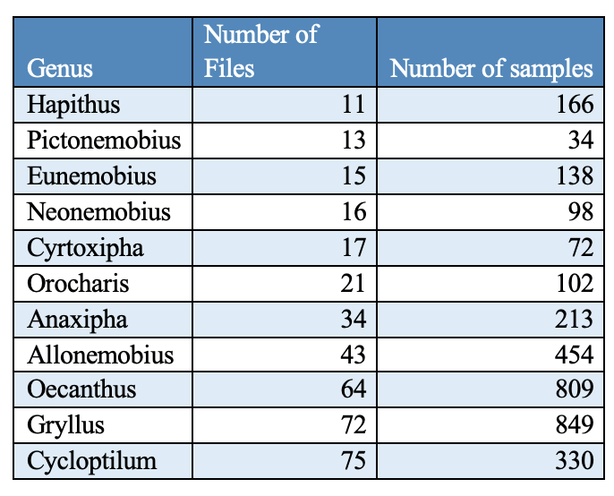
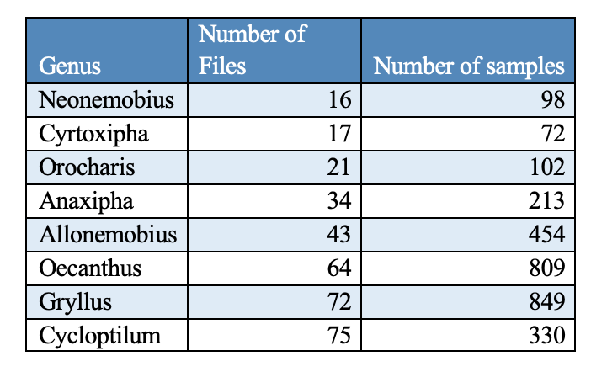
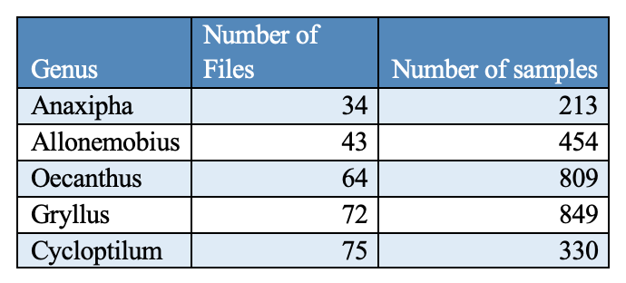
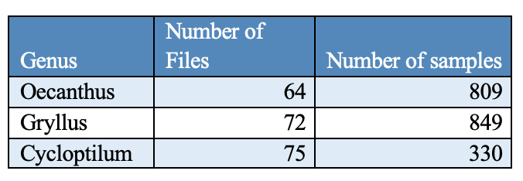
Species dataset (Gryllus genus)
List of species with corresponding number of audio files in species Dataset
List of Gryllus Species with more than 10 audio files (9 species set), 50 audio files (5 species set) and 70 audio files (3 species set)
Genus dataset
List of Genus with corresponding number of audio files in genus Dataset
List of Genus with more than 10 audio files (11 genus set) , 15 audio files (8 genus set), 130 audio files (5 genus set) and 60 audio files (3genus set)

Slide 16
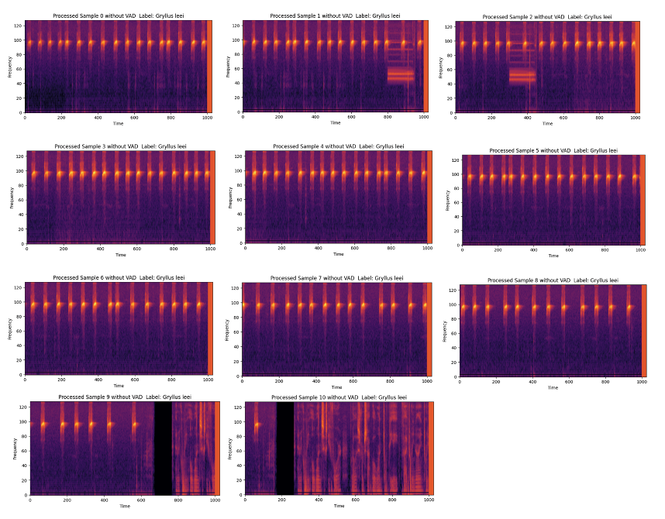

Mel spectrogram image for Gryllus Leei for an audio file ( without any processing)
The audio sample is divided into eleven 10 second samples.
Phone ring as a noise can be be seen in 2nd sample.
The last two samples show human voice over.

Slide 17
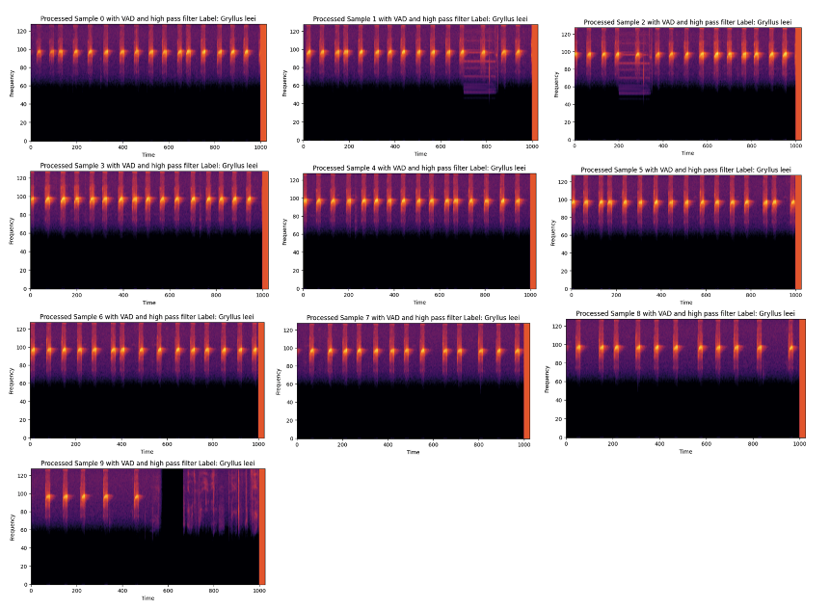
Mel spectrogram image for Gryllus Leei for an audio file ( after applying VAD and high pass filter)
The audio file is reduced to 10 samples after VAD is applied.
Phone ring is suppressed.
The human voiceover is removed, with very little amount left.

Slide 18
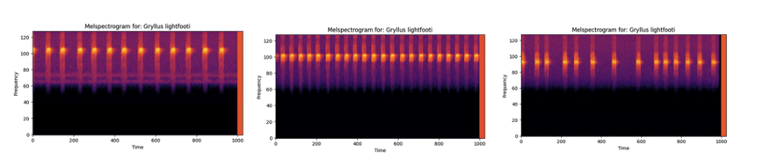
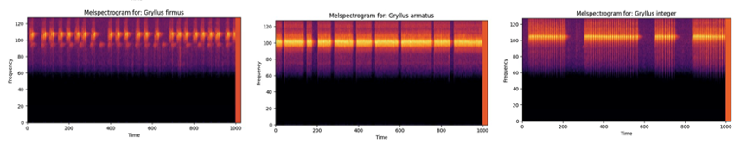
Feature Extraction
The filtered audio files in each set are transformed into 2D images known as Mel spectrograms.
The different pattern in songs can be analyzed using these images.
These differences help distinguish one species from another, although there are instances where similar patterns can cause confusion when attempting to differentiate between them.
Mel Spectrogram image for Gryllus lightfooti. These spectrograms are taken from different audio samples of same species.
Mel Spectrogram images for Gryllus Firmus, Gryllus integer, Gryllus Armatus respectively. These spectrograms are taken from different audio samples of different species.

Slide 19
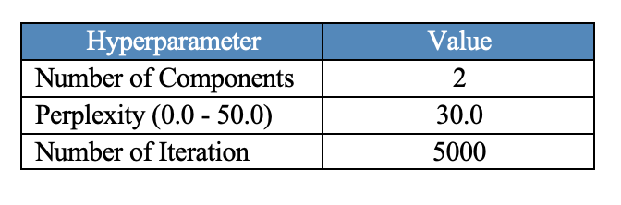
Dimensionality reduction
To visually understand intra-species and intra-genus relation 2D plotting was done.
The Mel spectrogram image had high dimensionality of 131,072 features.
PCA was applied to reduce the features to 2000 dimensions.
T-SNE plotting was done on those 2000-dimension features to understand the clustering.
Values for sci-kit learn t-SNE Hyperparameters

Slide 20
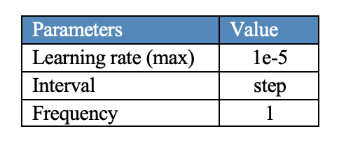
Model Configuration
A pre-trained model called Audio Spectrogram Transformer (AST) from the Hugging Face Transformer library (finetuned on AudioSet) is utilized as a foundation to build and train the classifier.
Audio information is converted into Mel spectrogram images and processed using Vision Transformer.
Pre-trained weights from "MIT/ast-finetuned-audioset-10-10-0.4593” was used.
The original model was configured for a total of 527 classes, but the classification task was adapted to work with 3, 5, and 9 classes for species dataset and 3,5,8 and 11 classes for genus dataset instead.
The Adam optimizer was utilized with a learning rate set to 1e-5 (experiments were done with two more learning rates 2e-5 and 3e-5), facilitating the optimization of model parameters during training.
The ‘OneCycleLR’ scheduler was applied to adjust the learning rate during training, optimizing the balance between convergence and exploration.
Values for OneCycleLR parameters

Slide 21
Continue..
Trainer setup was done with desired number of epochs (10 epochs) on two GPU devices.
The training was accelerated on the GPU and used Distributed Data Parallelism(ddp) to efficiently utilize multiple GPUs.
To find the best-performing model, ModelCheckpoint was employed to save the model at the end of each epoch.
Metrices like validation accuracy, precision, recall and f1-score were used to determine the best model.
Custom Dataset class inherited from Pytorch’s ‘Dataset’ class was applied to adjust the labels based on classification type: ‘species’ and ‘genus’.

Slide 22
experiments

Slide 23
Species Dataset
Experiments were conducted on 9 species, 5 species and 3 species sub-datasets.
Each sub-dataset was split into train and test samples with ratio 80:20.
Three different learning rates 1e-5, 2e-5 and 3e-5 were used for both imbalanced and balanced dataset , for each sub-datasets.
To address the class imbalance, undersampling and oversampling technique was applied.
Training was carried out for 10 epochs with batchsize 8 for each combination and model at the end of each epoch was saved.
Best model was chosen based on the metrices like validation accuracy, precision, recall and F1-score.
For validation, test samples were used on the best model chosen and confusion matrix was constructed to visualize the classification accuracy of each class. The matrix also helped in detecting the misclassification.

Slide 24
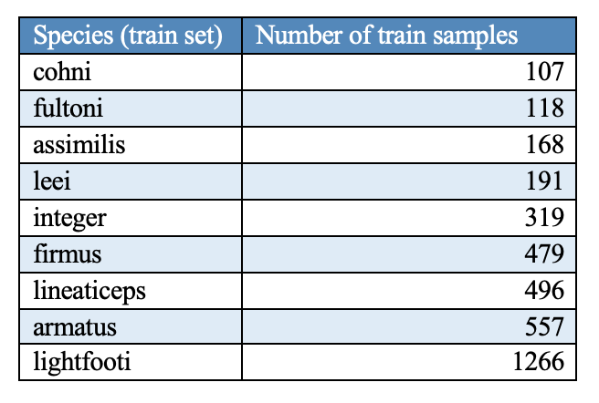
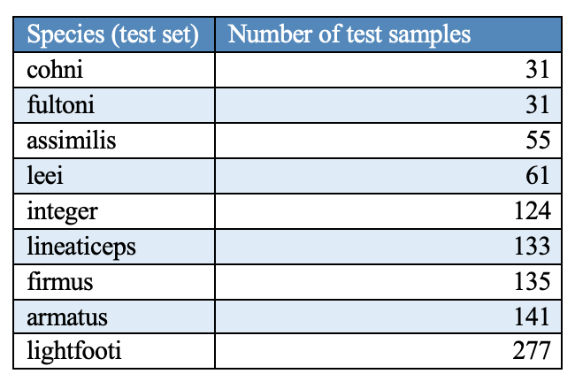
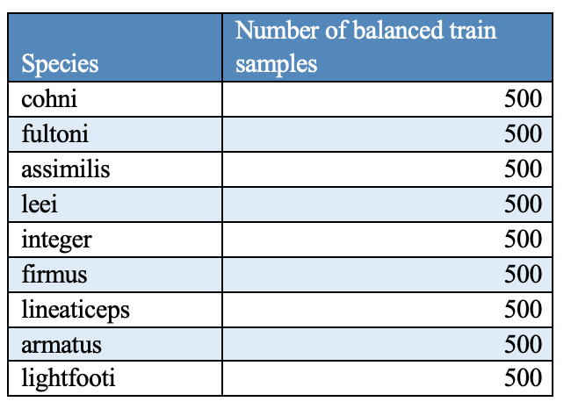
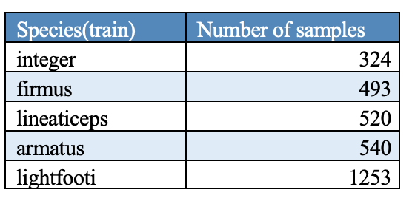
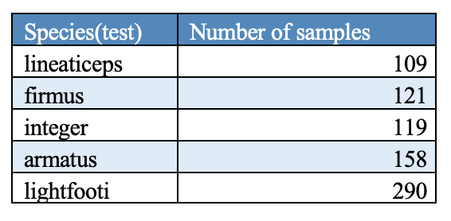
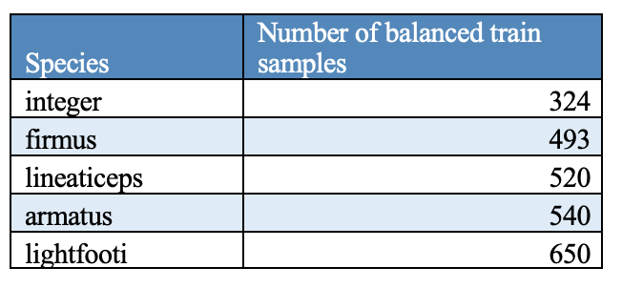
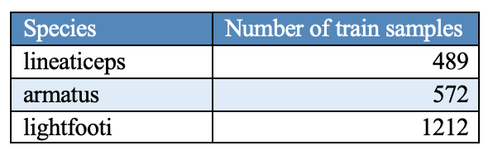
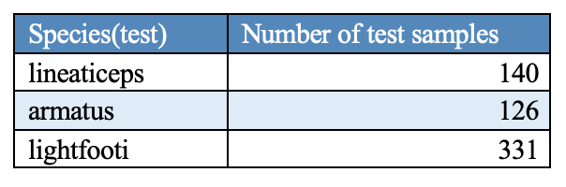
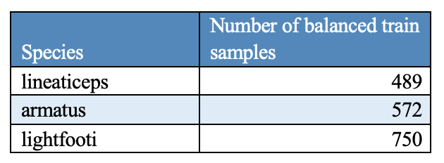
9 species train, test and balanced train samples
5 species train and test and balanced train samples
3 species train and test and balanced train samples

Slide 25
Genus Dataset
Experiments were conducted on 11 genus, 8 genus, 5 genus and 3 genus sub-datasets.
Each sub-dataset was split into train and test samples with ratio 80:20.
Three different learning rates 1e-5, 2e-5 and 3e-5 were used with each sub-datasets.
Training was carried out for 10 epochs with batchsize 8 and 4 , for each combination and model at the end of each epoch was saved.
Best model was chosen based on the metrices like validation accuracy, precision, recall and F1-score.
For validation, test samples were used on the best model chosen and confusion matrix was constructed to visualize the classification accuracy of each class. The matrix also helped in detecting the misclassification.

Slide 26
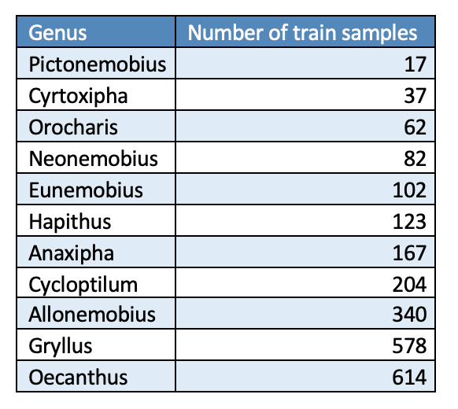
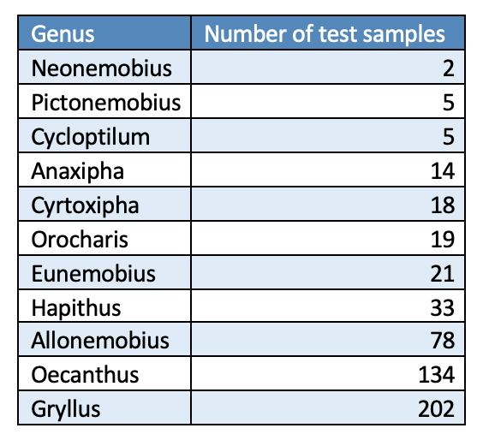
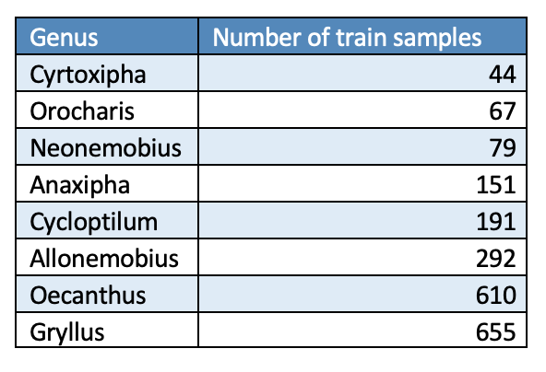
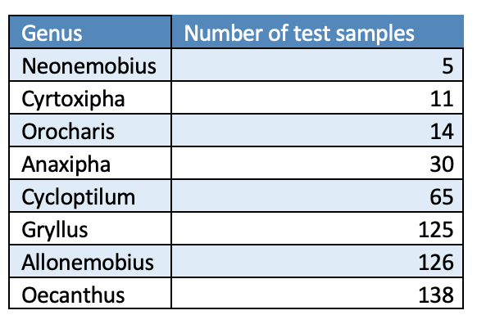
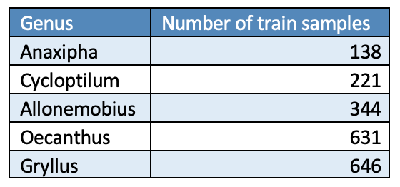
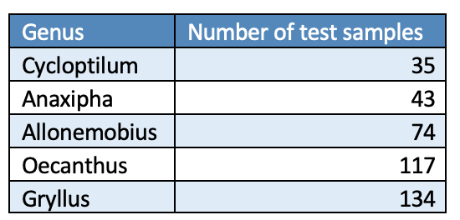
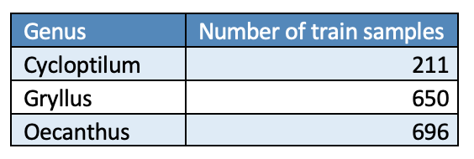
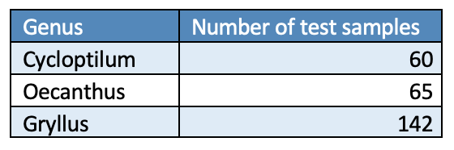
11 genus train and test samples
8 genus train and test samples
5 genus train and test samples
3 genus train and test samples

Slide 27
Results and Analysis

Slide 28
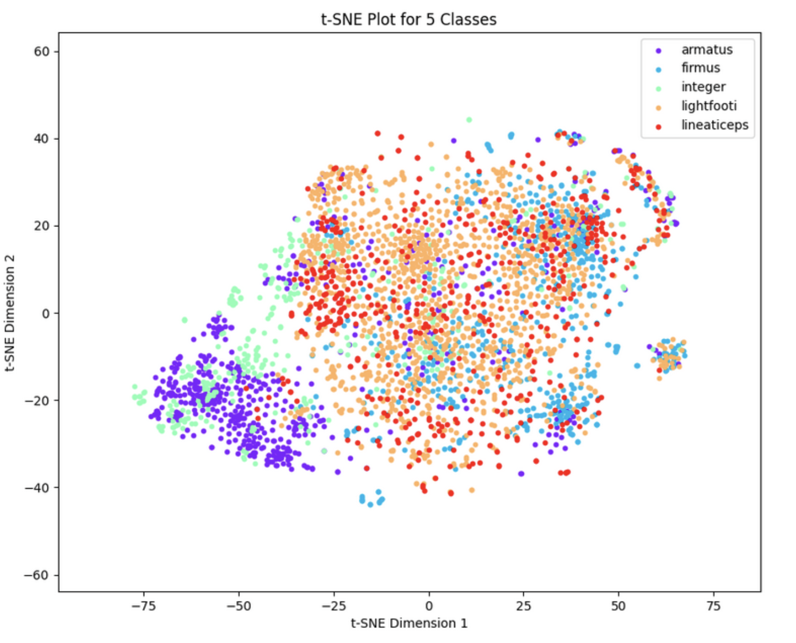
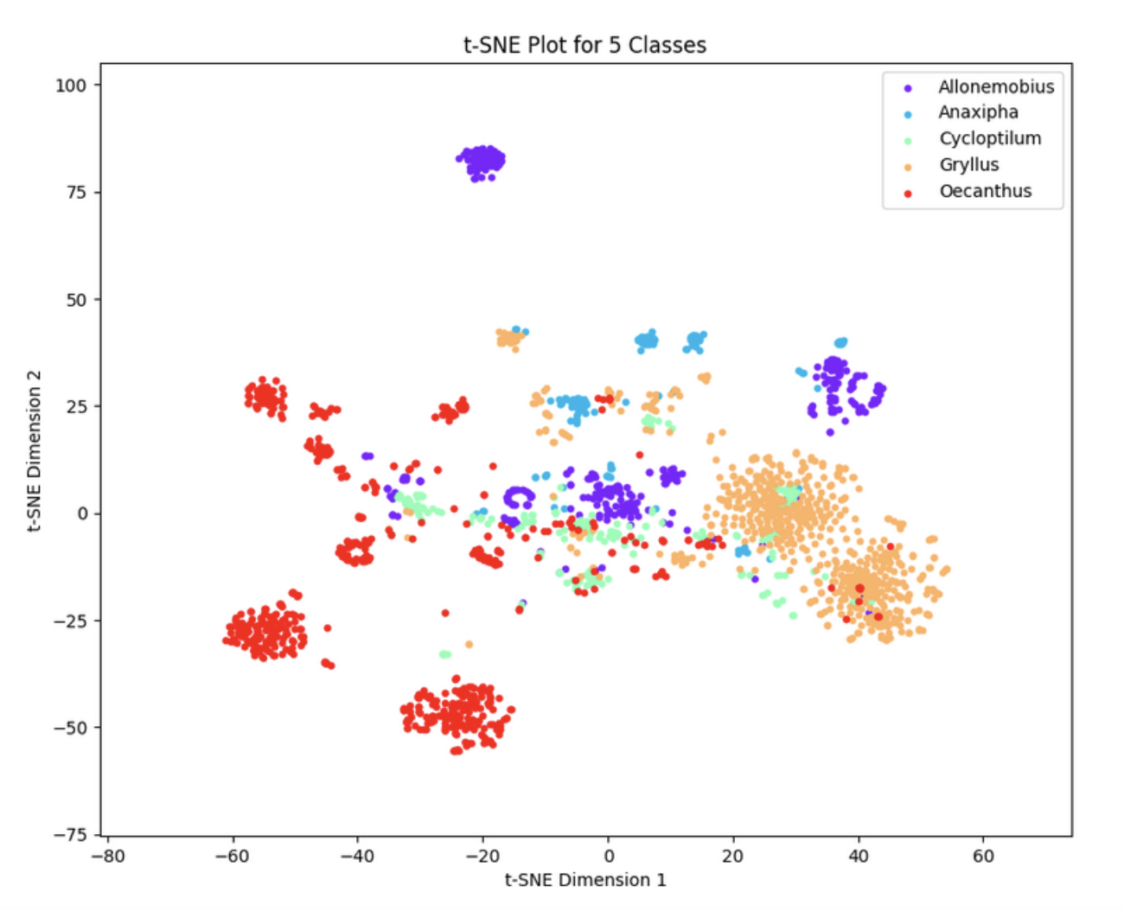
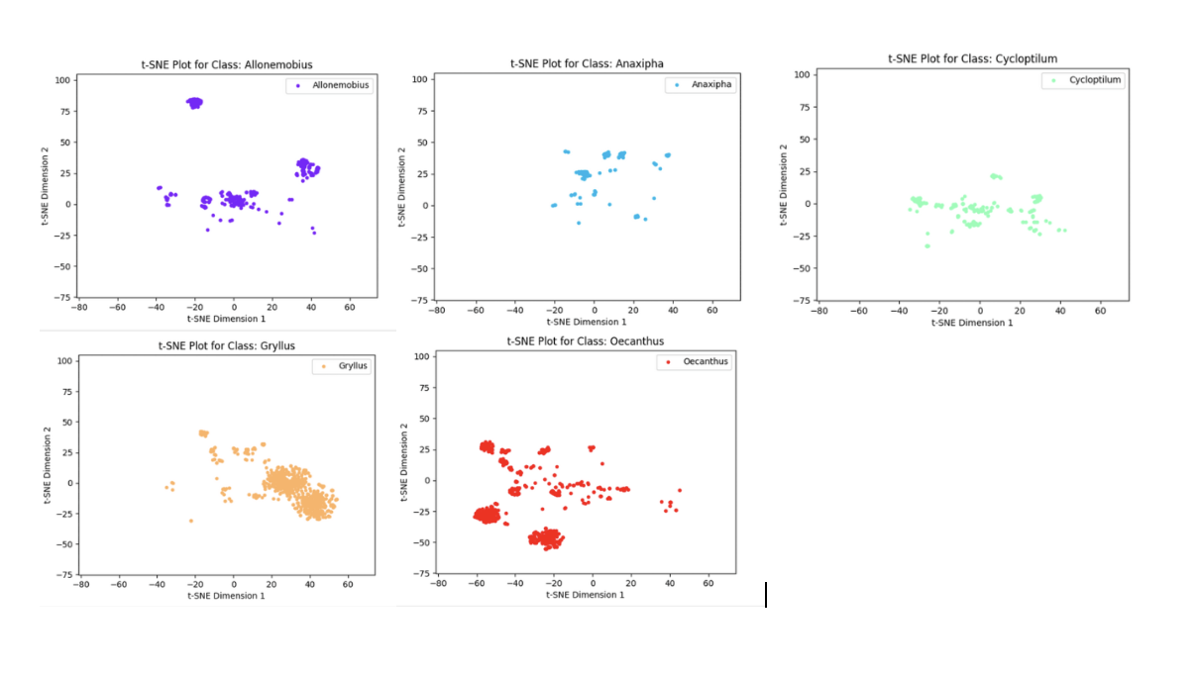
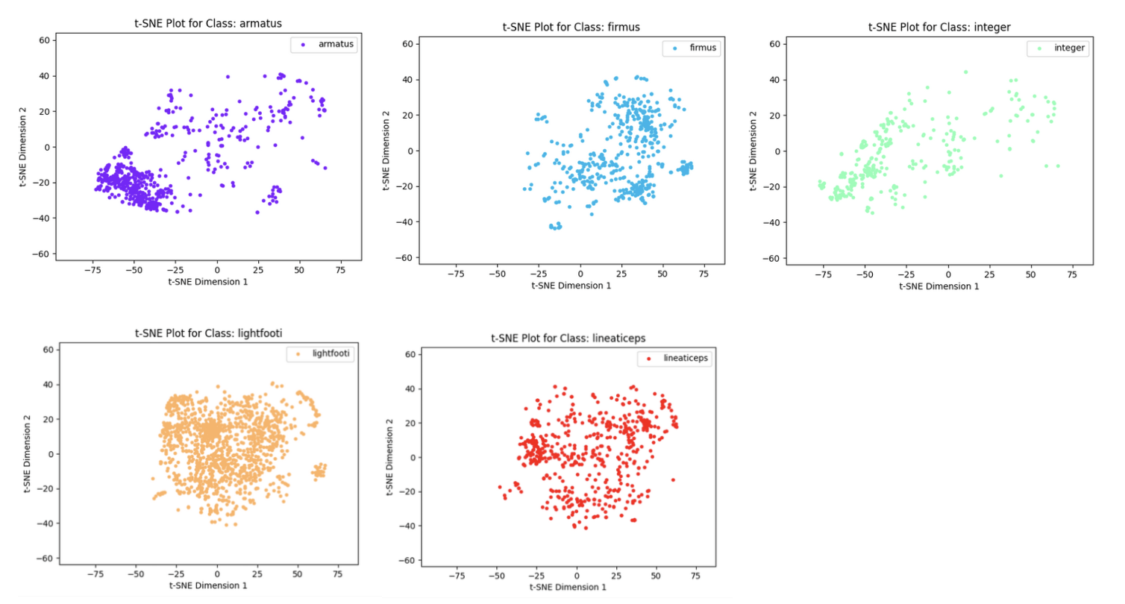
t-SNE Plot
Species dataset t-SNE plot
Genus dataset t-SNE plot

Slide 29
T-sne plot analysis
Same species tend to cluster together, indicating a relationship in their sounds.
The overlapping of different species can also be seen. This maybe because they belong to same genus ‘Gryllus’ and they might share similar features.
For genus dataset, plots show that different genera are visually separated, with few overlapping. This shows different genera have many distinct features ( with few commonness).
Genera with larger sample sizes tend to cluster together more tightly than those with smaller sample sizes.
Larger sample sizes provide more statistical power, allowing t-SNE to better capture the underlying structure and relationships within the data.
Besides the number of samples, the reason for scattered points could be that the sounds were from different crickets of the same type, and they were recorded in different situations.
Further research is needed to investigate the specific features that lead to these misclassifications.

Slide 30
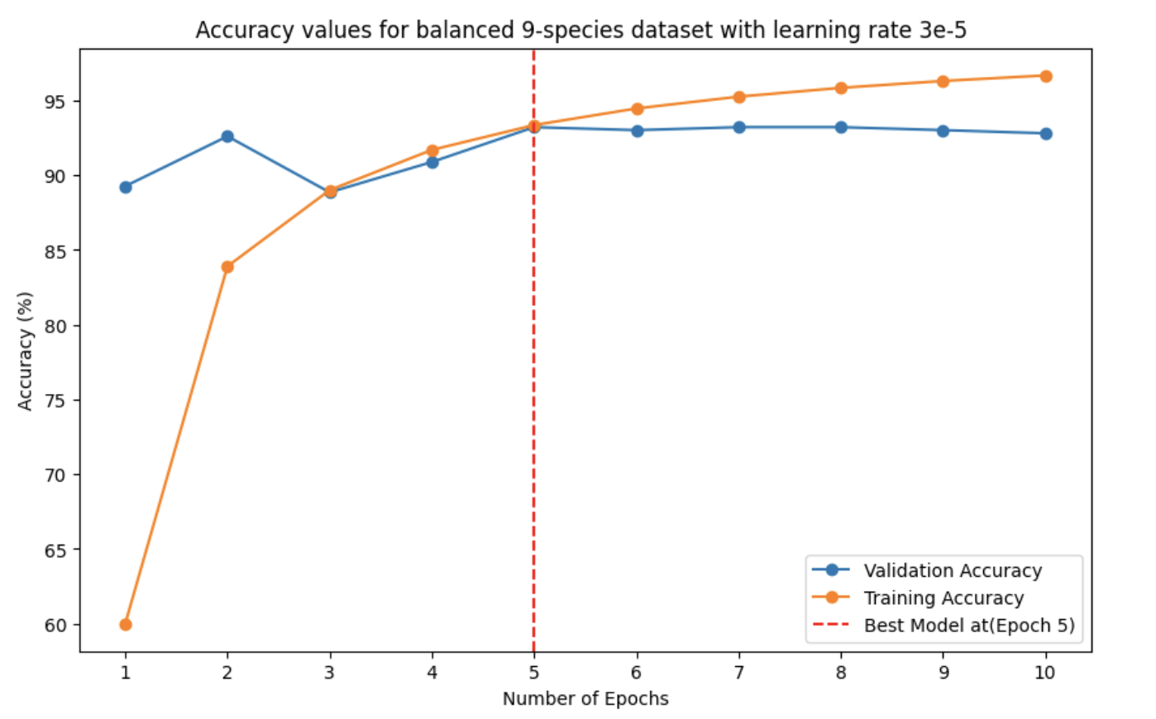
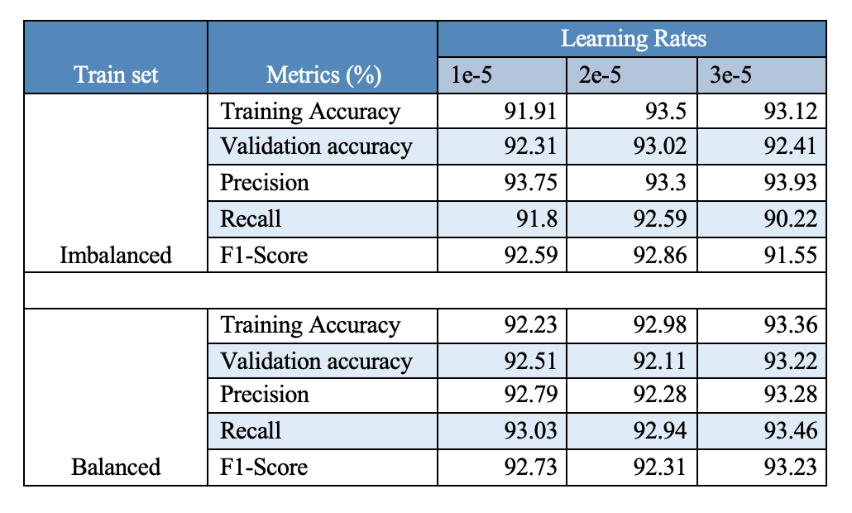
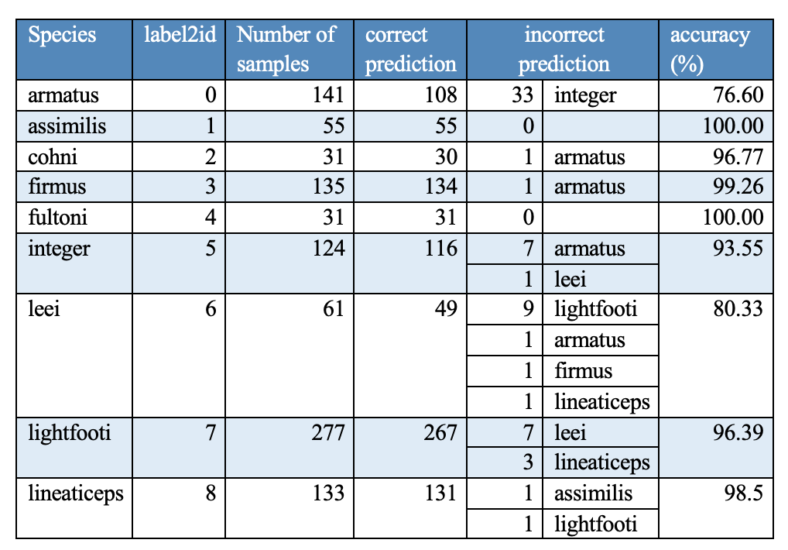

Experimental results (Species dataset)
Experiment 1: 9 Species
Best model chosen in this experiment was at epoch 5, with learning rate 3e-5 trained on balanced dataset. The validation accuracy was 93.22%.
This model was validated against the test samples (988 samples).
Overall good prediction accuracy, with some misclassification in few classes like ‘armatus’, ‘leei’ , ‘integer’ and ‘lightfooti’.
‘armatus’ misclassified as ‘integer’ and ‘leei’ as ‘lightfooti’ and vice-versa.
Accuracy curve for model trained on balanced dataset.
Metrics table for balanced and imbalanced 9-species set (Gryllus dataset)
Correct and incorrect prediction of species by the best model in this experiment
Confusion matrix for the best trained model on the prediction of 9-species test data

Slide 31




Experiment 2: 5 Species
Best model chosen in this experiment was at epoch 7, with learning rate 2e-5 trained on imbalanced dataset. The validation accuracy was 94.73%.
This model was validated against the test samples (797 samples).
Good prediction accuracy, with slight misclassification in few classes like ‘armatus’, and ‘integer’.
Interesting behavior: ‘armatus’ misclassified as ‘lightfooti’ but not vice-versa.
Accuracy curve for model trained on balanced dataset.
Metrics table for balanced and imbalanced 5-species set (Gryllus dataset)
Correct and incorrect prediction of species by the best model in this experiment
Confusion matrix for the best trained model on the prediction of 5-species test data

Slide 32




Experiment 2: 3 Species
Best model chosen in this experiment was at epoch 6, with learning rate 2e-5 trained on balanced dataset. The validation accuracy was 95.31%.
This model was validated against the test samples (597 samples).
Good prediction accuracy, with slight misclassification in few classes like ‘armatus’, and ‘lineaticeps’.
Interestingly, ‘lineaticeps’ was misclassified this time as ‘lightfooti’ and ‘armatus’.
Accuracy curve for model trained on balanced dataset.
Metrics table for balanced and imbalanced 3-species set (Gryllus dataset)
Correct and incorrect prediction of species by the best model in this experiment
Confusion matrix for the best trained model on the prediction of 3-species test data

Slide 33




Experimental results (Genus dataset)
Experiment 1 : 11 Genus
The best model chosen was trained on this dataset with Batchsize 4, giving the validation accuracy of 87.38% .
This model was validated against 531 test samples.
Prediction accuracy was small in numbers. This could due the huge class imbalance in the dataset.
Other metrices like precision, recall and f1-score were also lower.
Accuracy curve for model trained on dataset with Batchsize 4. Best model chosen at epoch 7.
Metrics table for models trained on batchsize 8 and 4 and learning rate 1e-5. 11 genus set
Correct and incorrect prediction of species by the best model in this experiment (11 genus set)
Confusion matrix for the best trained model on the prediction of 11 genus test data

Slide 34




Experiment 2 : 8 Genus
The model in this set behaved not much different than the 11 genus set, yielding the best validation accuracy of 87.74%
Validation was done on 514 test samples.
‘Anaxipha’ and ‘Cyrtoxipha’ in lower prediction accuracy.
Accuracy curve for model trained on dataset with Batchsize 8. Best model chosen at epoch 7.
Metrics table for models trained on batchsize 8 and 4 and learning rate 3e-5. 8genus set
Correct and incorrect prediction of species by the best model in this experiment (8 genus set)
Confusion matrix for the best trained model on the prediction of 8 genus test data

Slide 35




Experiment 3 : 5 Genus
For the 5 genus set, the model achieved an accuracy of 93.56% with a learning rate of 3e-5 and batch size 8.
This model was validated against the test samples (403 samples).
Overall good prediction accuracy, with some misclassification in few classes like ‘Anaxipha’ and ‘Cycloptilum’
Comparatively more balanced data than 11 genus and 8 genus sets, resulted in higher accuracy.
Accuracy curve for model trained on dataset with Batchsize 8. Best model chosen at epoch 6.
Metrics table for models trained on batchsize 8 and 4 and learning rate 3e-5. 5genus set
Correct and incorrect prediction of species by the best model in this experiment (5 genus set)
Confusion matrix for the best trained model on the prediction of 5 genus test data

Slide 36




Experiment 4: 3 Genus
For 3 genus set, the best model reached 94.27% accuracy with a learning rate of 1e-5 and batch size 4.
This model was validated against the test samples (267 samples).
Overall good prediction accuracy, with some misclassification in few classes like ‘Gryllus’ and ‘Oecanthus’.
Best accuracy achieved over all the experiments.
Accuracy curve for model trained on dataset with Batchsize 4. Best model chosen at epoch 5.
Metrics table for models trained on batchsize 8 and 4 and learning rate 1e-5. 3 genus set
Correct and incorrect prediction of species by the best model in this experiment (3 genus set)
Confusion matrix for the best trained model on the prediction of 3 genus test data

Slide 37
Discussion and Conclusion

Slide 38

Discussion
Species Dataset
The model performed well with accuracies more than 92% on all the different imbalanced/balanced data scenarios, reaching upto 95.31% when data had less class imbalance.
In the 9 species set, the balanced dataset shows better validation accuracy (93.22%) than the imbalanced dataset (92.41%). This is likely because the 9 species dataset has a significant imbalance in samples for each class.
In the 5 species set, the balanced dataset has a slightly lower validation accuracy (94.35%) compared to the imbalanced dataset (94.73%). This might be due to the approach taken for balancing this dataset.
The validation accuracy in the 3 species set remains consistent at 95.31% for both imbalanced and balanced datasets. This could be attributed to the minimal difference in the number of samples.
In all three sets (9 species, 5 species, and 3 species), the validation accuracy either equals or exhibits a very minor difference in the imbalanced dataset when compared to the balanced one, suggesting that addressing dataset imbalance ( by undersampling and oversampling) did not significantly impact the model performance.

Slide 39

Continue..
Genus Dataset
In the 11 genus and 8 genus datasets, the validation accuracy is around 87%, which is lower compared to the more balanced 5 genus and 3 genus datasets where accuracy exceeded 92%, reaching a high of 94.27%.
Lower accuracy in the former sets may be attributed to the significant imbalance in the number of samples, making it challenging for the model to learn and distinguish patterns from the audio samples.
In the more evenly distributed datasets, the model showed stable performance, with accuracy remaining consistent across different batch sizes and learning rates.

Slide 40
Robustness of model:
The small change in validation accuracy between imbalanced and balanced datasets indicates that the model is quite steady and works consistently across imbalanced and balanced data.
Also, tweaking the hyperparameters doesn't seem to affect the model's performance much, implying that it remains stable regardless of these adjustments.
The only noticeable change comes from the quality of the data, which the model is sensitive to.
Limitations and future work:
We employed the VAD technique to detect and remove human voiceover, but this approach has its limitations. Exploring alternative techniques for human voice removal could address the issue of human voice not getting completely removed for some audio files.
Mel Spectrograms have a limitation – they might miss some fine-scale details. An alternative approach could be multi-resolution analysis, which captures details at various scales, including both low-level and high-level frequencies.
Despite the model performing well and demonstrating robustness, some misclassifications occurred. Identifying the specific features responsible for these misclassifications should be addressed in future research.
Notes:
CAT (Causal AudioTransformer) consisting of MRMF feature extraction. Multi resolution multi feature.

Slide 41




Comparison with previous work:
Species dataset
Genus dataset
Comparing the Validation Accuracy for species dataset with previous work (LeNet-5 and SCNNB)
Comparing the Validation Accuracy for genus dataset with previous work (LeNet-5 and SCNNB)

Slide 42
conclusion
Transformer model’s performance is stable regardless of the balanced and imbalanced dataset, and different hyperparameters. Only the baseline is changing and is sensitive to the data quality.
The model achieved an impressive validation accuracy of 95.31% when trained on the top 3-species dataset. It demonstrated strong performance particularly when the dataset was plentiful and evenly distributed. Even with smaller and imbalanced datasets, like in genus dataset, its accuracy remained respectable, reaching 87%.
Comparing this with the previous work on SCNNB (top 9-species set), our transformer model outperformed with an accuracy of 93.22%. Yet, in the case of the genus dataset, the model achieved its highest accuracy of 94.27% when trained on the 3-genus dataset, closely approaching the performance of the SCNNB model.
The potential impact of using transformers for cricket classification extends to biodiversity studies, conservation efforts, ecological research, and technological advancements for a better understanding and preservation of the natural world.

Slide 43
Acknowledgements
Dr. Yoonsuck Choe (advisor, committee chair), Dr. Shuiwang Ji (committee), Dr. Hojun Song (committee) for their continuous support and guidance.
Dr. Hojun Song for providing the the datasets for both species(592 audio files) and genus (441 audio files) dataset.
Venkata Bhanu Teja for providing the initial code base for fine-tuning and model training.
Jin Hyun Park and Shiva Mahato for their valuable insights and discussion.
Texas ViDal for providing high performance server, which expedited the progress of this work.
Gryllus field cricket song video and zoomed stridulation video taken from as a snippet from YouTube video.
https://www.youtube.com/watch?v=2DLmg2qj_6I (Gryllus field cricket song)
https://www.youtube.com/watch?v=fh3uNUrAnss (zoomed stridulation video)

Slide 44
Reference
[1] D. Otte, “Evolution of cricket songs,” Journal of orthoptera research, no. 1, pp. 25–49, 1992.
[2] D. Bentley and R. R. Hoy, “The neurobiology of cricket song,” Scientific American, vol. 231,no. 2, pp. 34–45, 1974.
[3] R. Liu, L. Ondrej and C. Smith, “Analyzing cricket songs with machine learning”, Undergraduate research scholar thesis, Texas A&M University, 2022.
[4] A. Vaswani, N. Shazeer, N. Parmar, J. Uszkoreit, L. Jones, A. N. Gomez, Ł. Kaiser, and I. Polosukhin, “Attention is all you need,” Advances in neural information processing systems,vol. 30, 2017.
[5] C. M. Bishop and H. Bishop, “Deep learning: foundations and concepts,” (No Title), 2024.
[6] A. Dosovitskiy, L. Beyer, A. Kolesnikov, D. Weissenborn, X. Zhai, T. Unterthiner, M. Dehghani, M. Minderer, G. Heigold, S. Gelly, et al., “An image is worth 16x16 words: Transformers for image recognition at scale,” arXiv preprint arXiv:2010.11929, 2020.
[7] E. Aljalbout, V. Golkov, Y. Siddiqui, M. Strobel, and D. Cremers, “Clustering with deep learning: Taxonomy and new methods,” arXiv preprint arXiv:1801.07648, 2018.
[8] J. Brownlee, “How to develop a cnn for mnist handwritten digit classification,” Machine Learning Mastery, 2019.

Slide 45
Thank you (Any Questions!)

Slide 46


Balanced
Imbalanced
Same validation accuracy 95.31% but achieved at different epochs ( epoch 5 for imbalanced and epoch 6 for balanced) and precision , recall, F1 are also different. Higher in balanced.

Slide 47








Gryllus species Mel specs

